Slide 1

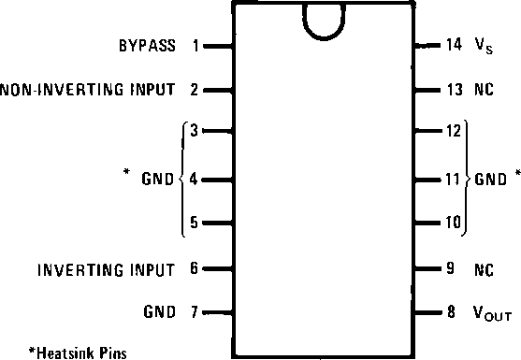
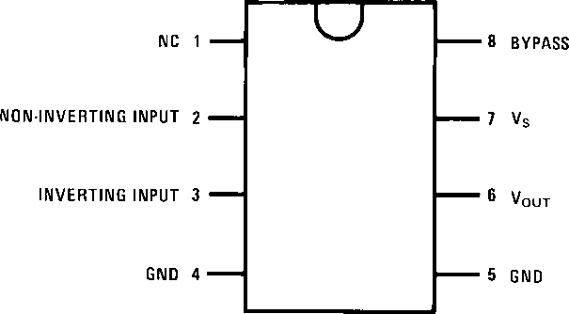
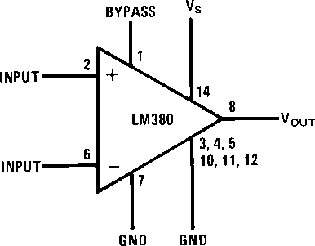
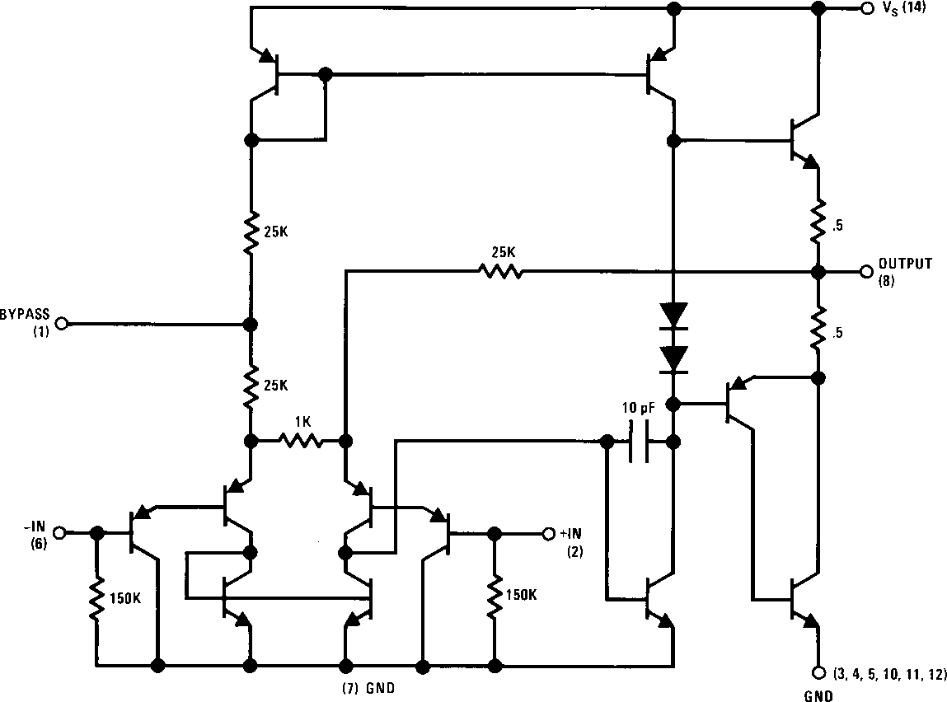
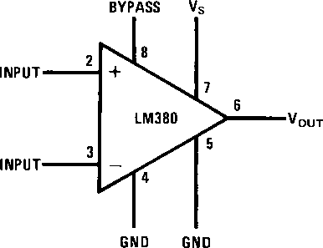
December 1994
LM380 Audio Power Amplifier
LM380 Audio Power Amplifier
General Description
The LM380 is a power audio amplifier for consumer applica- tion. In order to hold system cost to a minimum, gain is internally fixed at 34 dB. A unique input stage allows inputs to be ground referenced. The output is automatically self centering to one half the supply voltage.
The output is short circuit proof with internal thermal limiting. The package outline is standard dual-in-line. A copper lead frame is used with the center three pins on either side com- prising a heat sink. This makes the device easy to use in standard p-c layout.
Uses include simple phonograph amplifiers, intercoms, line drivers, teaching machine outputs, alarms, ultrasonic driv- ers, TV sound systems, AM-FM radio, small servo drivers, power converters, etc.
A selected part for more power on higher supply voltages is available as the LM384. For more information see AN-69.
Features
^{Y} Wide supply voltage range
^{Y} Low quiescent power drain
^{Y} Voltage gain fixed at 50
^{Y} High peak current capability
^{Y} Input referenced to GND
^{Y} High input impedance
^{Y} Low distortion
^{Y} Quiescent output voltage is at one-half of the supply voltage
^{Y} Standard dual-in-line package
Connection Diagrams (Dual-In-Line Packages, Top View)
TL/H/6977 – 1
Order Number LM380N See NS Package Number N14A
Block and Schematic Diagrams
LM380N
Order Number LM380N-8 See NS Package Number N08E
TL/H/6977 – 2
TL/H/6977 – 3
LM380N-8
TL/H/6977 – 4
^{C}1995 National Semiconductor Corporation TL/H/6977
TL/H/6977 – 5
RRD-B30M115/Printed in U. S. A.
LOMEX KFT 1134 Budapest Lehel u. 17 Tel.: 349-5906 Fax.: 320-3292
Honlap: www.lomex.hu E-mail: info@lomex.hu

Slide 2
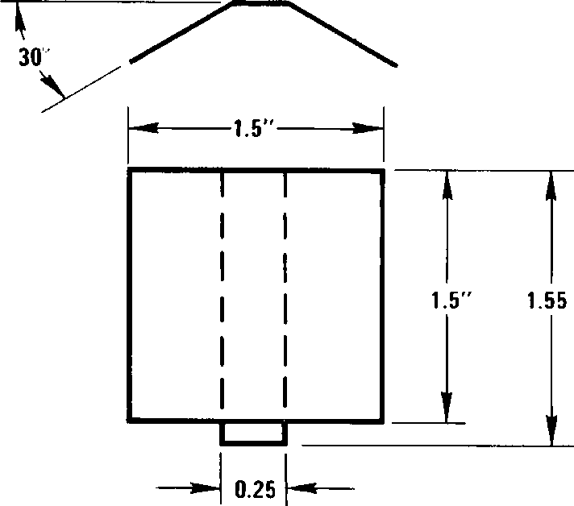
Absolute Maximum Ratings
If Military/Aerospace specified devices are required, please contact the National Semiconductor Sales Office/Distributors for availability and specifications.
Operating Temperature Junction Temperature
Lead Temperature (Soldering, 10 sec.) ESD rating to be determined
Thermal Resistance i_{JC} (14-Pin DIP) i_{JC} (8-Pin DIP) i_{JA} (14-Pin DIP) i_{JA} (8-Pin DIP)
0°C to ª70°C
ª150°C
ª260°C
Supply Voltage Peak Current
Package Dissipation 14-Pin DIP (Notes 6 and 7) Package Dissipation 8-Pin DIP (Notes 6 and 7) Input Voltage
22V
1.3A
8.3W
1.67W
g0.5V
30°C/W
37°C/W
79°C/W
107°C/W
Storage Temperature
^{b}65°C to ª150°C
Electrical Characteristics (Note 1)
Symbol | Parameter | Conditions | Min | Typ | Max | Units
^{P}OUT(RMS) | Output Power | R_{L} e 8X, THD e 3% (Notes 3, 4) | 2.5 |  |  | W
A_{V} | Gain |  | 40 | 50 | 60 | V/V
^{V}OUT | Output Voltage Swing | R_{L} e 8X |  | 14 |  | ^{V}p-p
^{Z}IN | Input Resistance |  |  | 150k |  | X
THD | Total Harmonic Distortion | (Notes 4, 5) |  | 0.2 |  | %
PSRR | Power Supply Rejection Ratio | (Note 2) |  | 38 |  | dB
V_{S} | Supply Voltage |  | 10 |  | 22 | V
BW | Bandwidth | P_{OUT} e 2W, R_{L} e 8X |  | 100k |  | Hz
I_{Q} | Quiescent Supply Current |  |  | 7 | 25 | mA
^{V}OUTQ | Quiescent Output Voltage |  | 8 | 9.0 | 10 | V
^{I}BIAS | Bias Current | Inputs Floating |  | 100 |  | nA
^{I}SC | Short Circuit Current |  |  | 1.3 |  | A
Note 1: V_{S} e 18V and T_{A} e 25°C unless otherwise specified.
Note 2: Rejection ratio referred to the output with C_{BYPASS} e 5 mF.
Note 3: With device Pins 3, 4, 5, 10, 11, 12 soldered into a ¹/1。" epoxy glass board with 2 ounce copper foil with a minimum surface of 6 square inches.
Note 4: C_{BYPASS} e 0.47 mfd on Pin 1.
Note 5: The maximum junction temperature of the LM380 is 150°C.
Note 6: The package is to be derated at 15°C/W junction to heat sink pins for 14-pin pkg; 75°C/W for 8-pin.
Heat Sink Dimensions
Staver Heat Sink #V-7 Staver Company
41 Saxon Ave.
P.O. Drawer H Bayshore, NY 11706
Tel: (516) 666-8000
Copper Wings 2 Required Soldered to Pins 3, 4, 5,
10, 11, 12
Thickness 0.04 Inches
TL/H/6977 – 6
2
LOMEX KFT 1134 Budapest Lehel u. 17 Tel.: 349-5906 Fax.: 320-3292
Honlap: www.lomex.hu E-mail: info@lomex.hu

Slide 3
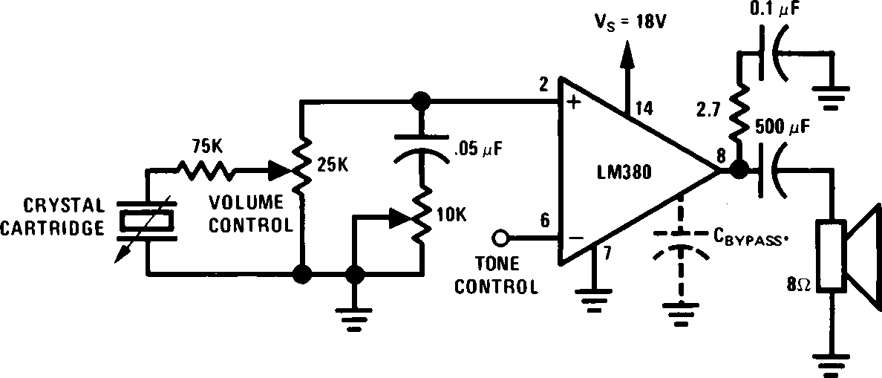
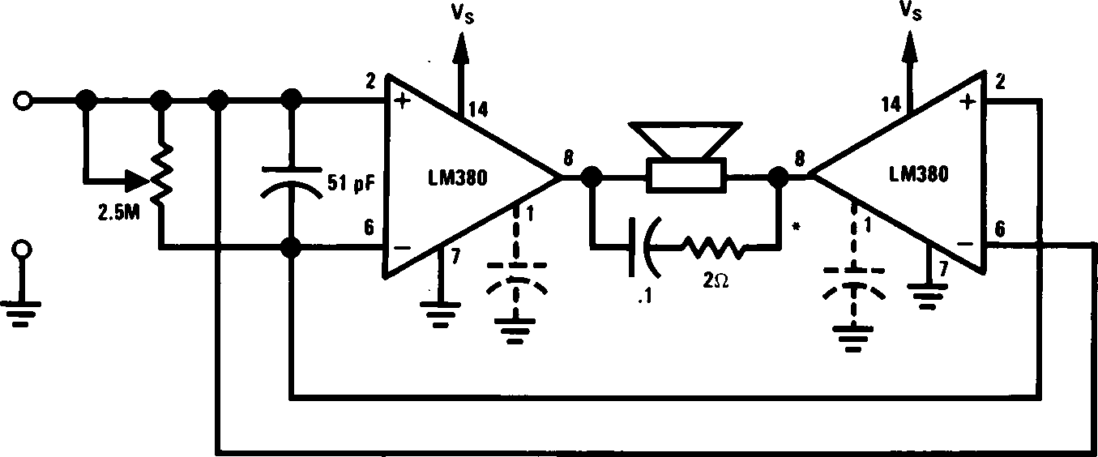
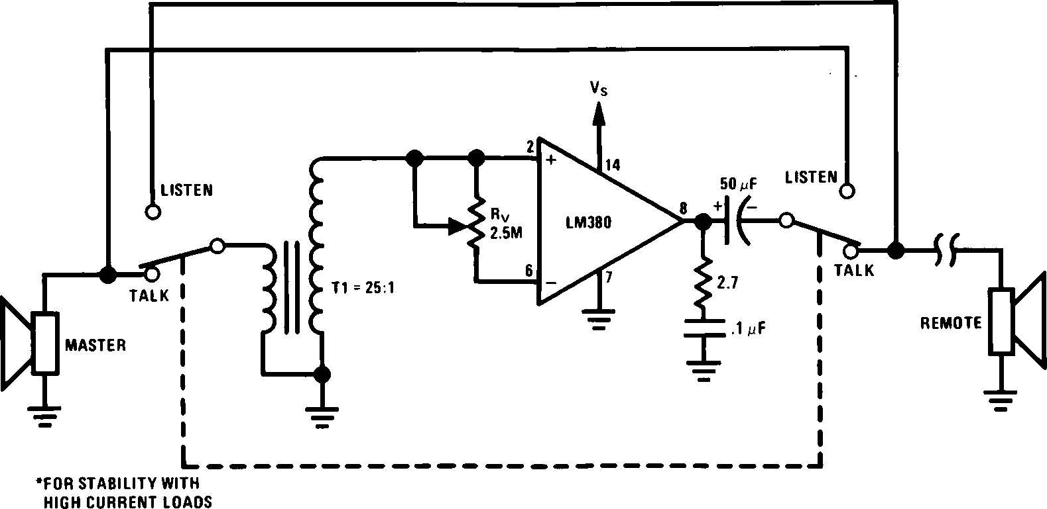
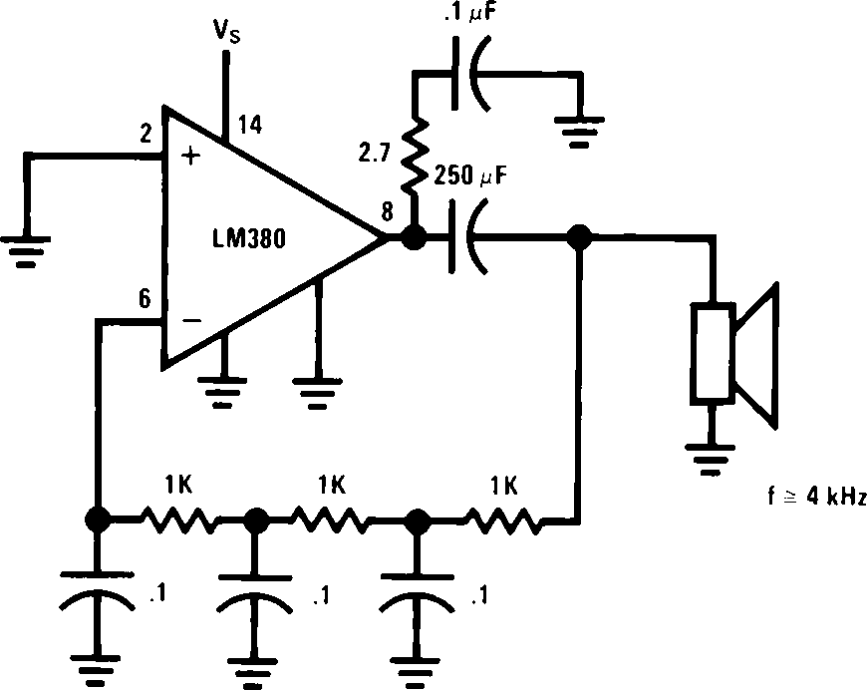
Typical Applications
Phono Amplifier
TL/H/6977 – 8
Bridge Amplifier
TL/H/6977 – 9
Intercom
TL/H/6977 – 10
Phase Shift Oscillator
TL/H/6977 – 11
LOMEX KFT 1134 Budapest Lehel u. 17 Tel.: 349-5906 Fax.: 320-3292
Honlap: www.lomex.hu E-mail: info@lomex.hu

